Slide 1
STEM-CHANGERS
Common e-ie Verbs

Slide 2
to close
cerrar
e-ie

Slide 3
to begin; start
comenzar
e-ie

Slide 4
to have fun, enjoy oneself
e-ie
divertirse

Slide 5
to begin; start
e-ie
empezar

Slide 6
to understand
entender
e-ie

Slide 7

to think
pensar
e-ie

Slide 8

to lose, miss
perder
e-ie

Slide 9
to prefer
preferir
e-ie

Slide 10
to want
querer
e-ie

Slide 11
to sit down
sentarse
e-ie

Slide 12
to feel
sentirse
e-ie

Slide 13
to suggest
sugerir
e-ie

Slide 14
COMMON
O-UE VERBS

Slide 15
to have lunch
almorzar

Slide 16
to count, tell a story
contar
O-UE

Slide 17
to return (an object)
devolver

Slide 18
to sleep
dormir

Slide 19
to find
encontrar

Slide 20
to play (a sport or game)
jugar

Slide 21
to rain
llover
( llueve )

Slide 22
to be able
poder

Slide 23
to remember
recordar

Slide 24
to return
volver

Slide 25
COMMON E-I VERBS

Slide 26
to say goodbye
despedirse

Slide 27
to ask for; order
pedir

Slide 28

to laugh
reírse

Slide 29

to repeat
repetir

Slide 30
to smile
sonreírse

Slide 31
to get dressed
vestirse

Slide 32
servir
to serve

Slide 33
GUIR - UIR VERBS

Slide 34

seguir
to follow; continue

Slide 35
concluir
to conclude

Slide 36
construir
to construct

Slide 37
contribuir
to contribute

Slide 38
destruir
to destroy

Slide 39
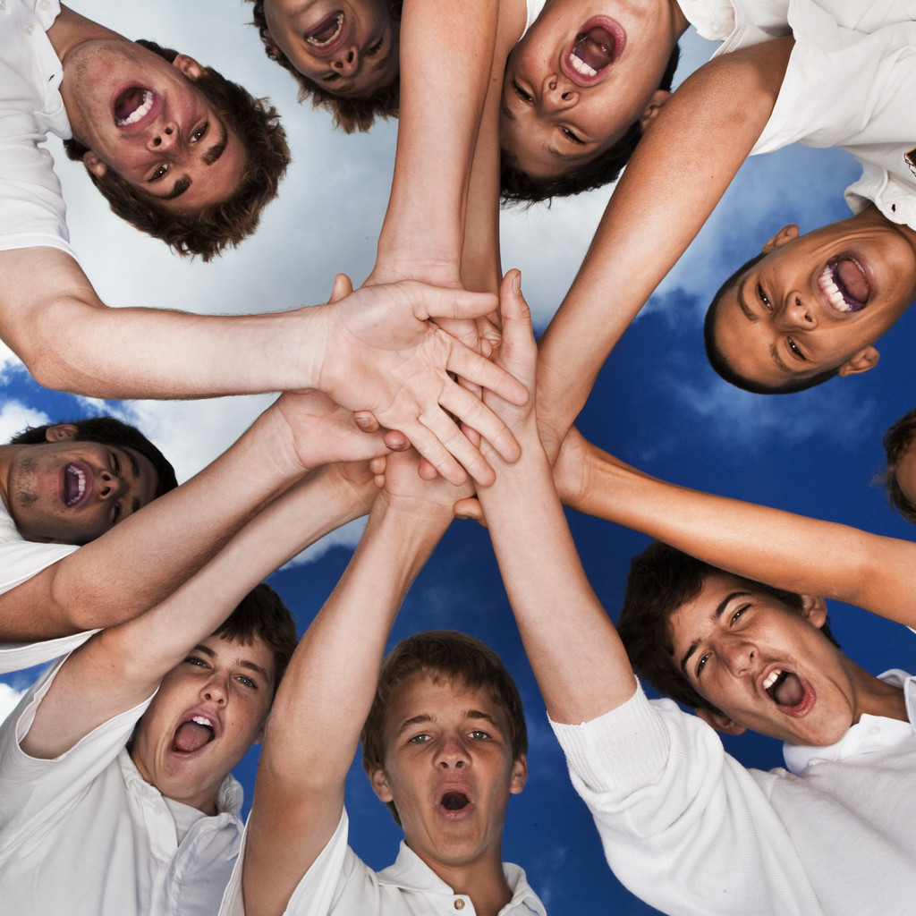
incluir
to include

